Slide 1
Assignment 5 Q&A
Yuyan Li

Slide 2
You CAN use edge(*), cart2pol(*), imbinarize(*)
You CAN’T use hough(*), houghlines(*) if you are using MATLAB
You CAN’T use cv2.HoughlinesP or houghline function from scikit-image, or other built-in hough line detection functions.
Display edge maps, hough space image and the final result.

Slide 3
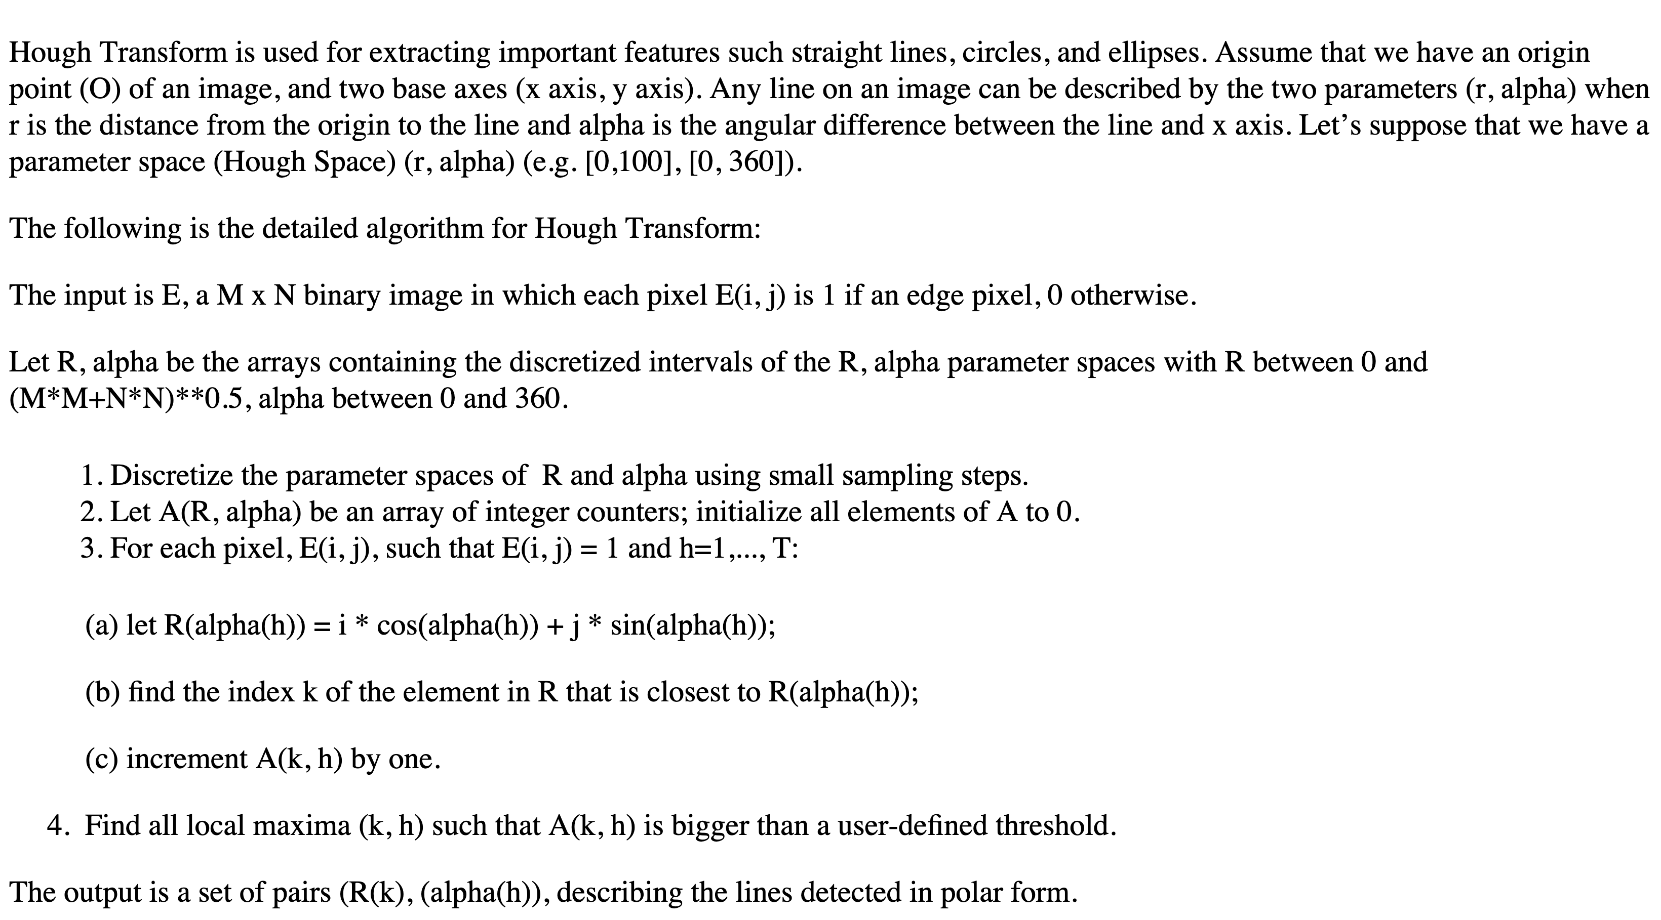
Steps of Hough Line Transform

Slide 4
Steps of Hough Line Transform
Read an example image, find the edge map.
Decide on the range of ρ and θ. The range of θ is [ 0, 360 ] degrees and ρ is [ 0, d ] where d is the length of the edge image’s diagonal.
Create a 2D array called the accumulator representing the Hough Space with dimension (num_rhos, num_thetas) and initialize all its values to zero.
For every pixel on the edge image, check whether the pixel is an edge pixel. If it is an edge pixel, calculate the corresponding ρ and θ based on its Cartesian coordinates, find the θ and ρ index in the accumulator, and increment the accumulator base on those index pairs.
Loop through all the values in the accumulator. If the value is larger than a certain threshold, get the ρ and θ index, get the value of ρ and θ from the index pair which can then be converted back to the form of y = ax + b.

Slide 5

Convert Cartesian to polar coordinates:
Convert polar to Cartesian:

Slide 6
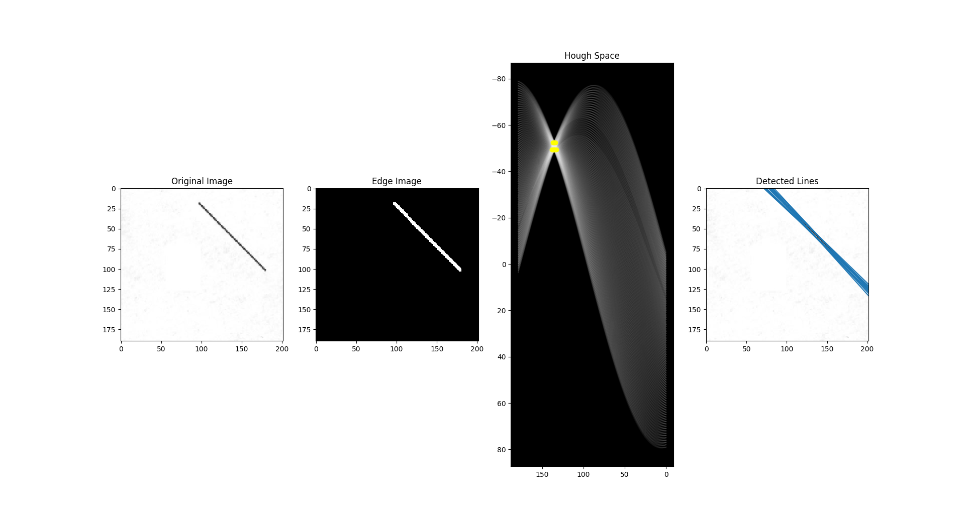
An example

Slide 7
Resources
https://towardsdatascience.com/lines-detection-with-hough-transform-84020b3b1549
https://scikit-image.org/docs/0.11.x/auto_examples/plot_line_hough_transform.html
https://www.mathworks.com/help/images/hough-transform.html?s_tid=srchtitle

